Slide 1




U.S. Senators Tweets
May 15, 2025

Slide 2
Table of Contents
1. Introduction
4. BerTopic
2. Data Preparation
5. Training Model &
Evaluation
3. Sentiment Analysis
6. Results & Findings

Slide 3
01
Introduction

Slide 4
Project Objective
Utilizing Natural Language Processing (NLP) concepts and techniques
Process a real-world dataset
Prepare it for model training
Train NLP algorithms
Analyze model performance

Slide 5


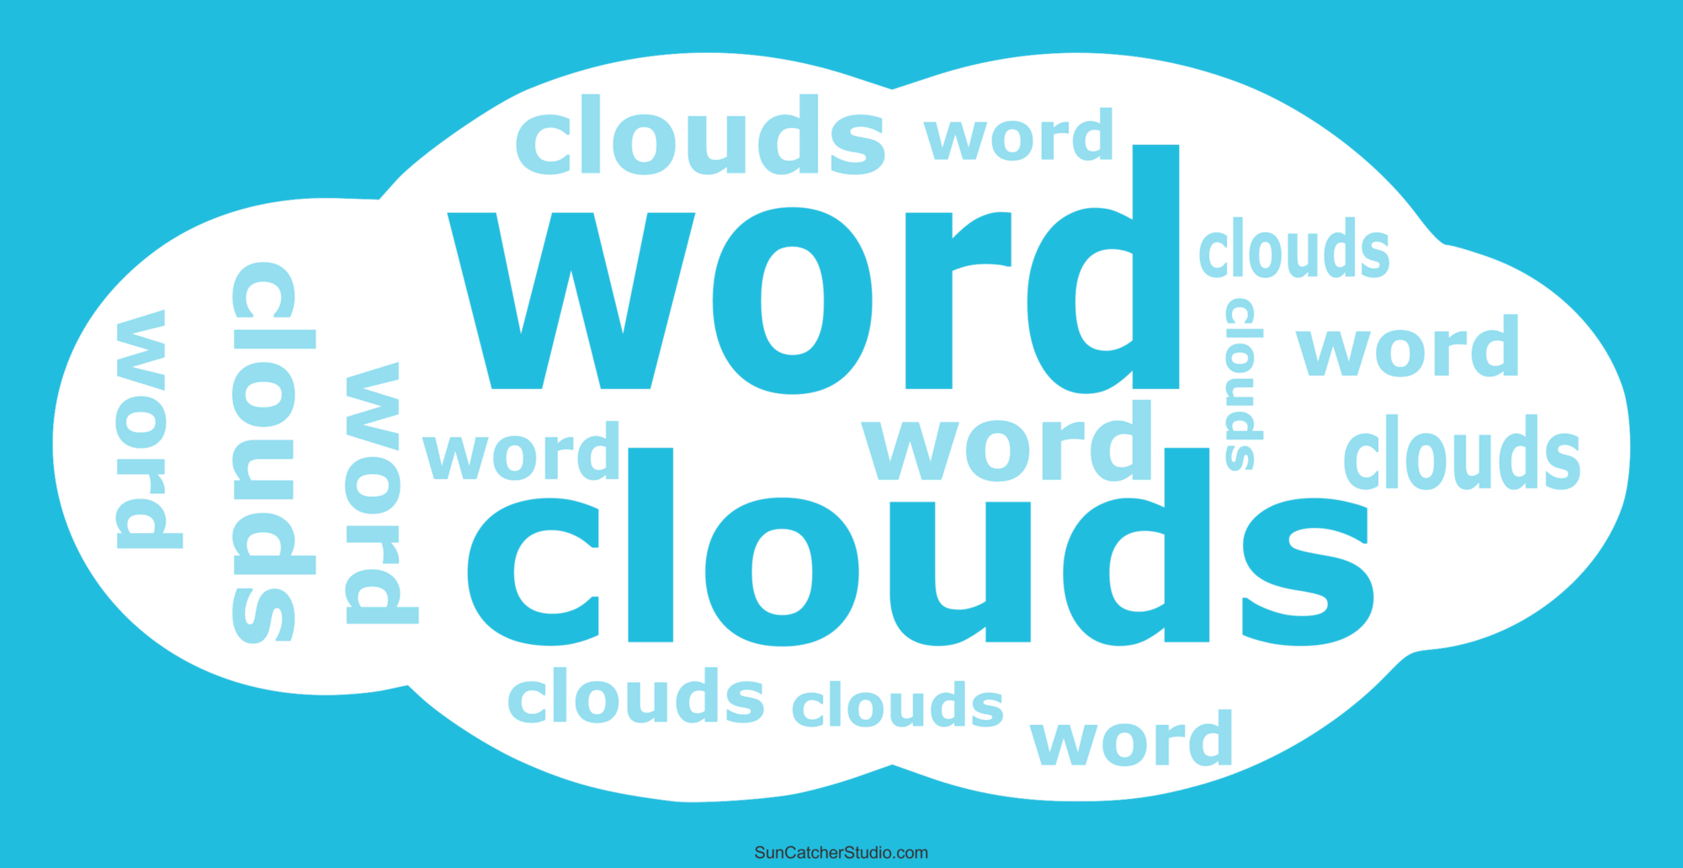
NLP Techniques
Sentiment Analysis
BERTopic
WordCloud
Measure the positivity or negativity of tweets
Creates topics from text data
Visual representation of text data where the size of words indicates frequency

Slide 6
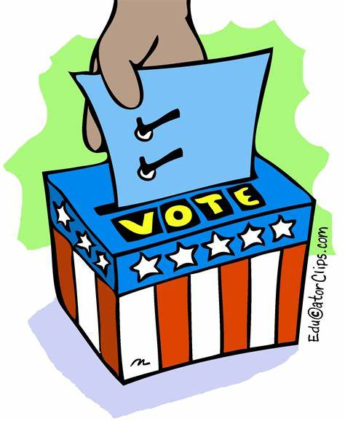

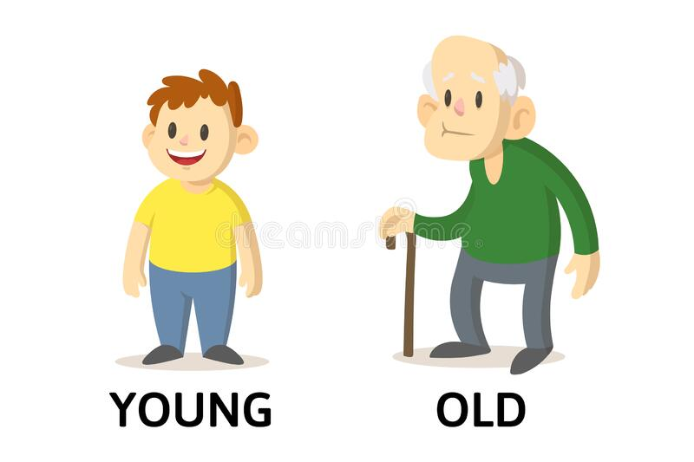
Research Questions
Election Outcome Correlation
Regional
Patterns
Generational
Trends
Do sentiment trends align with winning or losing the 2020 election?
Is there a significant difference in sentiment between winning and losing senators?
Which topics are most or least discussed in each region of the US?
Do senators from certain regions express more positivity or negativity?
Do senators of different age groups show different sentiment tendencies?
How does age impact the topics senator’s most commonly discuss?

Slide 7
02
Data Preparation

Slide 8
Data Sources and Enrichment
🗂️ Tweet Dataset
~72,000 tweets from U.S. Senators in 2020
🌐 Supplementary Data
Wikipedia web scrape of current Senators (names, state, party, age)
Manually curated mapping of:
Twitter usernames to senators
2020 election outcomes (win/loss, margin, incumbency)
🔗 Data Integration
Merged tweet dataset with senator info using username
Notes:
Merged tweet dataset with senator info using username
Created master DataFrame with: state, senator, party, age, election_winner, margin, incumbent, etc.

Slide 9
Data Preparation
Steps Taken
Checked and handled missing values
Normalized text values (e.g., title case for names, upper case for states)
Removed punctuation, stopwords, and duplicates
Converted appropriate columns to categorical or numeric types
Tweet Preprocessing
Applied NLP pipeline:
Tokenization → Lowercasing → Stopword removal
POS tagging → Lemmatization via WordNet
Created clean text column: clean_combined_text

Slide 10
03
Sentiment Analysis

Slide 11

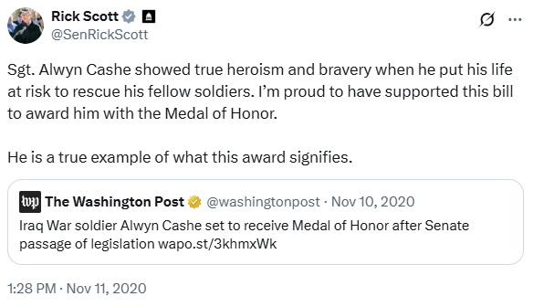
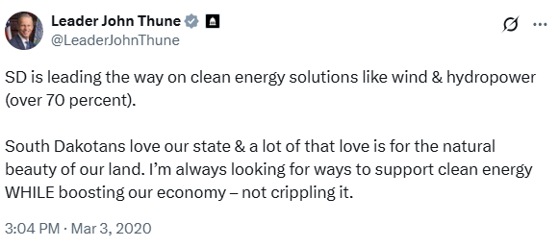
Sentiment Analysis
Highest Sentiment Score
0.99
0.99
0.99

Slide 12

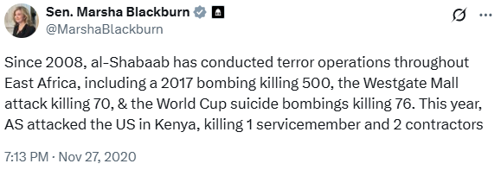
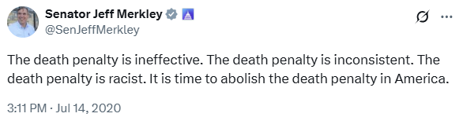
Sentiment Analysis
Lowest Sentiment Score
-0.99
-0.98
-0.98

Slide 13
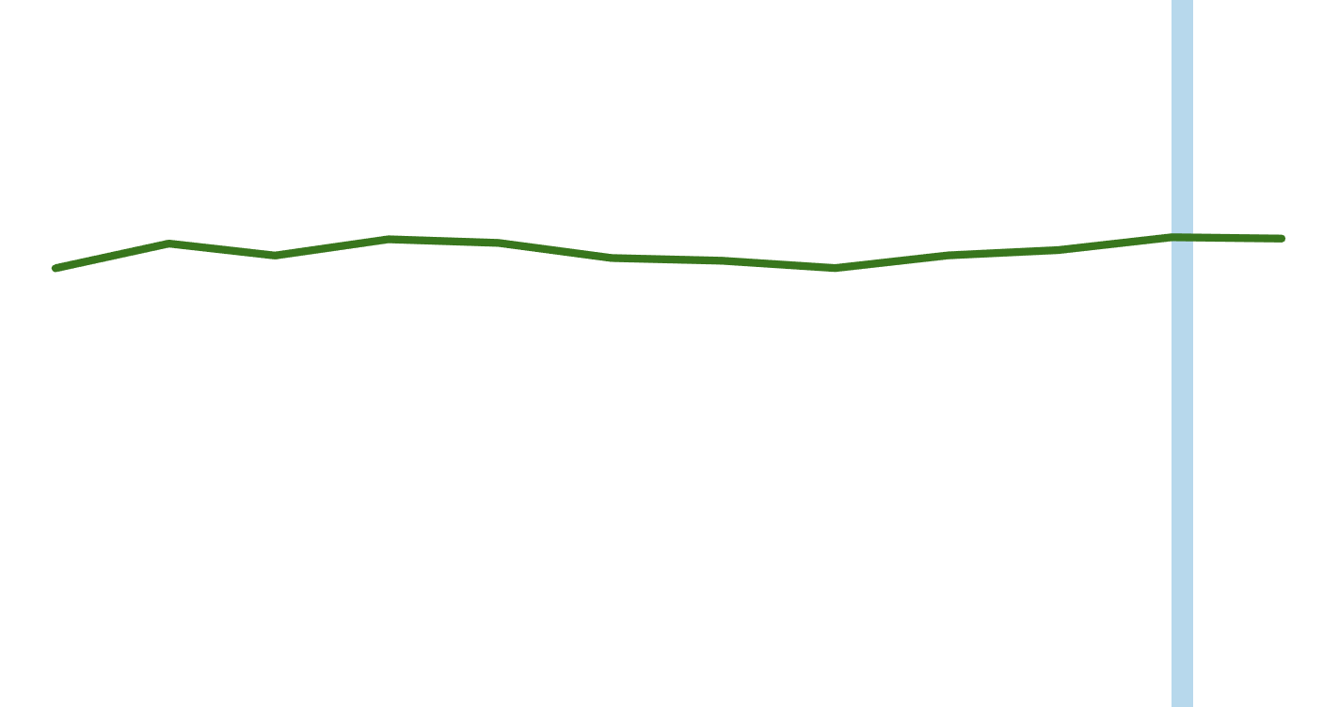
Sentiment Analysis
2020 Sentiment Score Trending
Election Day
1.0
Positive
0
Negative
-1.0
Jan
Feb
Mar
Apr
May
Jun
Jul
Aug
Sep
Oct
Nov
Dec

Slide 14
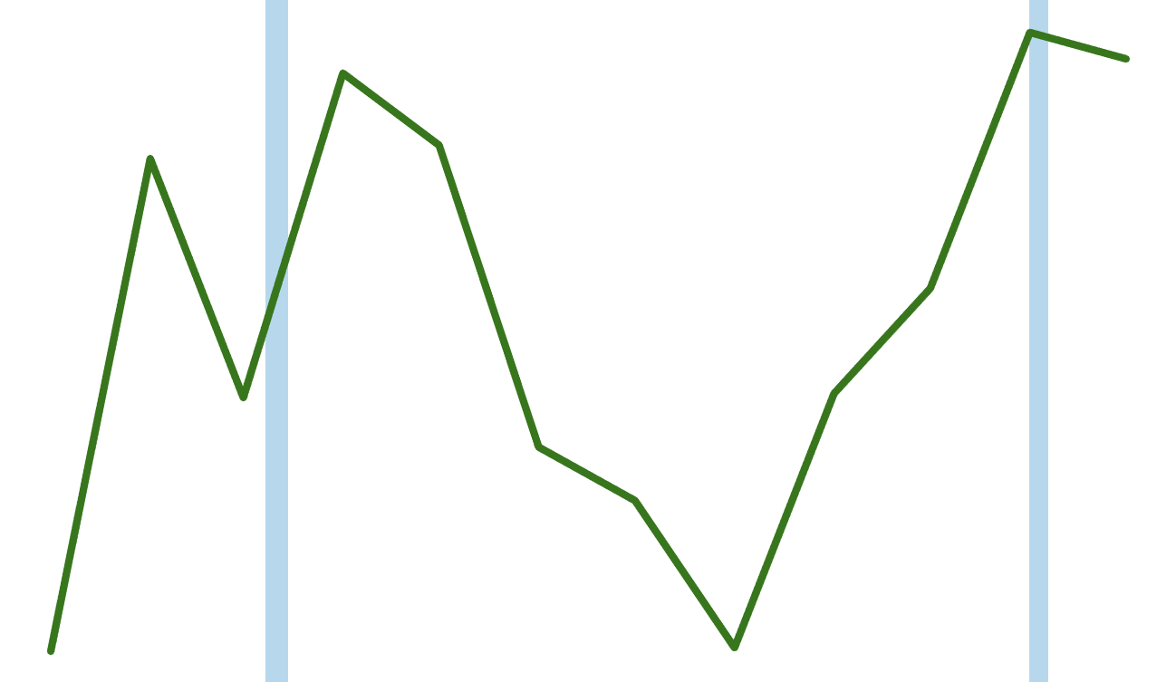
Sentiment Analysis
2020 Sentiment Score Trending
Election Day
0.33
0.32
0.31
0.30
Positive
0.29
0.28
COVID-19
0.27
0.26
0.25
0.24
Jan
Feb
Mar
Apr
May
Jun
Jul
Aug
Sep
Oct
Nov
Dec

Slide 15
04
BerTopic

Slide 16
BerTopic
Model Used: BERTopic (Transformer-based Topic Modeling)
Steps:
Embedded tweets using transformer models (e.g., Sentence-BERT)
Clustering of tweets into meaningful topics
Visualization of topic distributions across senators
Advantages Over LDA:
Captures contextual meaning better
Better suited for short texts like tweets
Dynamic, interpretable topics

Slide 17



BerTopic
Popular Topics
J
F
M
A
M
J
J
A
S
O
N
D
Relief
[‘relief’, ‘unemployment’, ‘package’]
Unemployment peaked at 14.8% in April 2020, the highest since the Great Depression
503
22
Nursing
[‘coronavirus’, ‘pandemic’, ‘nurse’]
COVID-19 pandemic was officially declared in the U.S. on March 13th, 2020
256
25
Barrett
[‘barrett’, ‘judge’, ‘coney’]
In October 2020, Amy Coney Barrett was confirmed by the Senate into the Supreme Court
706
22
22

Slide 18
05
Training Model & Evaluation

Slide 19
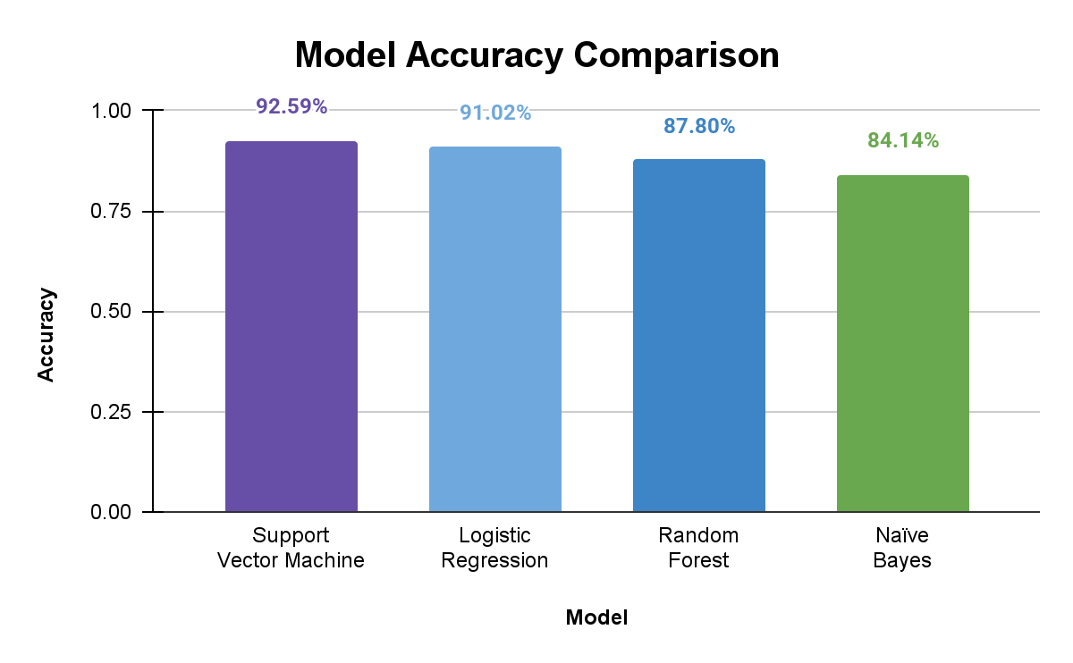
Training Model & Evaluation
High-performing models like SVM and Logistic Regression enhance our ability to quantify political tone, which we later relate to election outcomes.

Slide 20
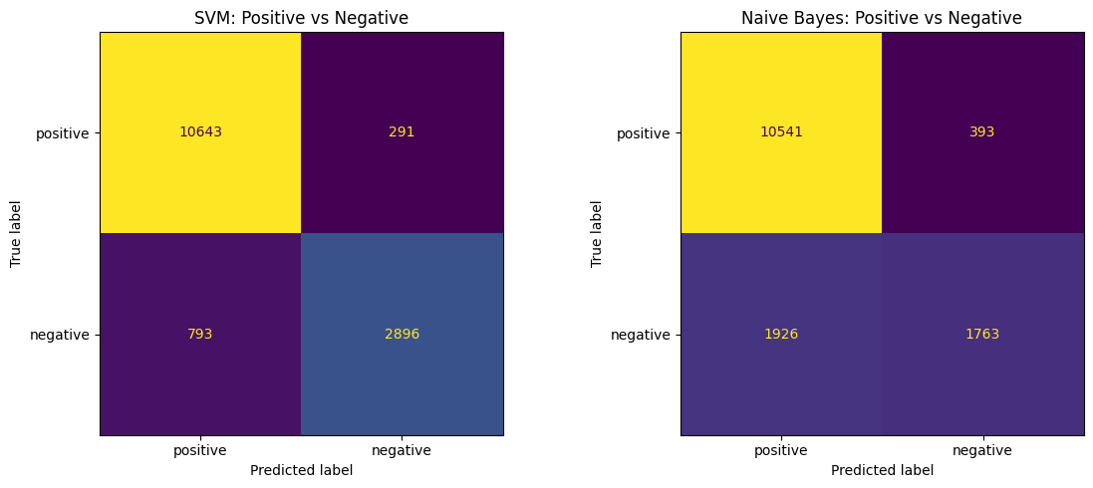
Best vs. Worst Performing Models: Confusion Matrices for SVM and Naive Bayes
How accurately the model classified positive and negative tweets, with correct predictions appearing along the diagonal.

Slide 21
06
Results & Findings

Slide 22
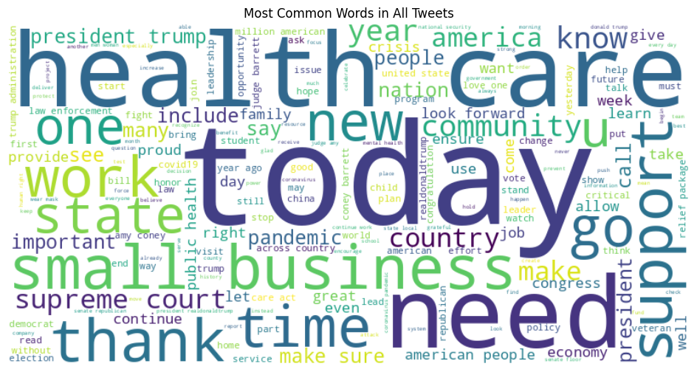
WordCloud

Slide 23
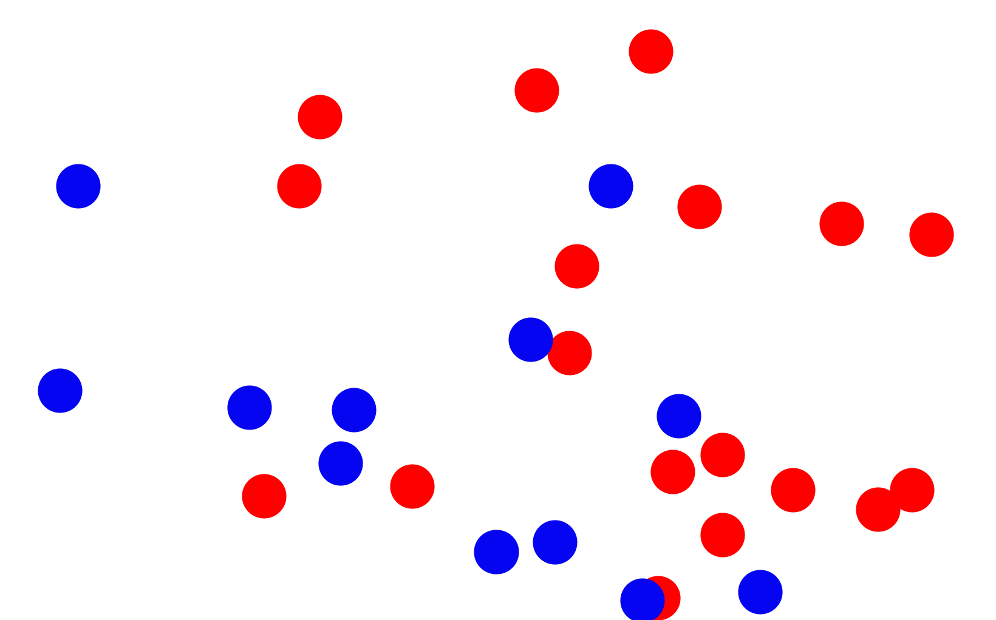
Election Outcome Correlation
2020 Election Results
Democrat
Republican
50
40
30
Margin of Victory
20
10
0
0
0.1
0.2
0.3
0.4
0.5
0.6
Avg. Sentiment Score

Slide 24
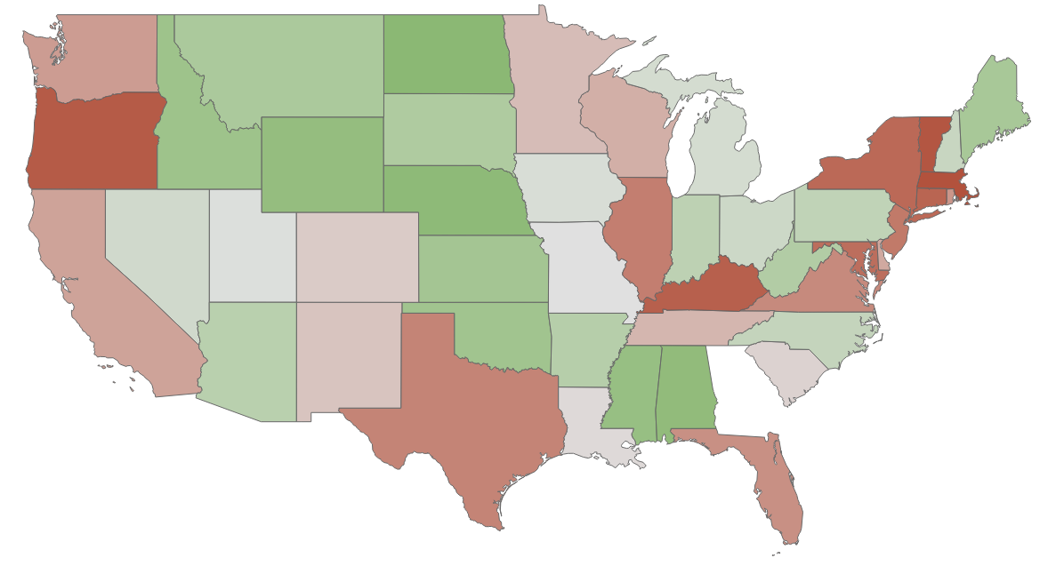


Regional Patterns
1
49
Sentiment Ranking
Midwest
0.34
West
0.31
South
0.30
Northeast
0.18

Slide 25
Regional Patterns
Common Topics
Midwest
West
Nursing [‘coronavirus’, ‘pandemic’, ‘nurse’]
Climate [‘climate’, ‘energy’, ‘land’]
Agriculture [‘farmer’, ‘producer’, ‘rancher’]
Relief [‘relief’, ‘unemployment’, ‘package’]
Climate [‘climate’, ‘energy’, ‘land’]
Wealth Gap [‘billionaire’, ‘wage’, ‘richest’]
South
Northeast
Disasters [‘wildfire’, ‘hurricane’, ‘fire’]
Impeachment [‘impeachment’, ‘trial’, ‘witness’]
China [‘china’, ‘communist’, ‘chinese’]
Postal [‘usps’, ‘mail’, ‘postmaster’]
Relief [‘relief’, ‘unemployment’, ‘package’]
Healthcare [‘condition’, ‘care’, ‘affordable’]

Slide 26


Generational Trends
Average Tweets Per Username
Generation X
Age 40-55
Baby Boomer
Age 56-74
Traditionalist
Age 75-95
29.6
Impeachment
[‘impeachment’,
‘trial’,
‘witness’]
15.4
12.9
17.6
Social Media
[‘facebook’,
‘twitter’,
‘tech’]
9.1
7.3

Slide 27
Conclusion
Logical
Conclusions
Tweets generally showed neutral-to-positive sentiment, with partisan and regional differences in both sentiment and topics discussed, especially around major events like COVID-19 and the 2020 election
Practical
Implications
Understanding sentiment trends on social media can help strategists craft effective messaging and predict shifts in public opinion over time
Future
Improvements
Expand the dataset to include more political figures and public opinion, refine preprocessing to better handle sarcasm and context, and enhance sentiment analysis with fine-tuned models for greater accuracy

Slide 28
Q&A
CIS 9665
Tenzin Damdul | Alba Marsela | Matthew Kelsall
May 15, 2025

